Slide 1
The team
Group 1:
Yusuf sobhy ali
Amr Khaled abu Hashem
Amr Khaled elsherkawy
Amr elsayed
Mohamed osama

Slide 2
Loan modelling

Slide 3
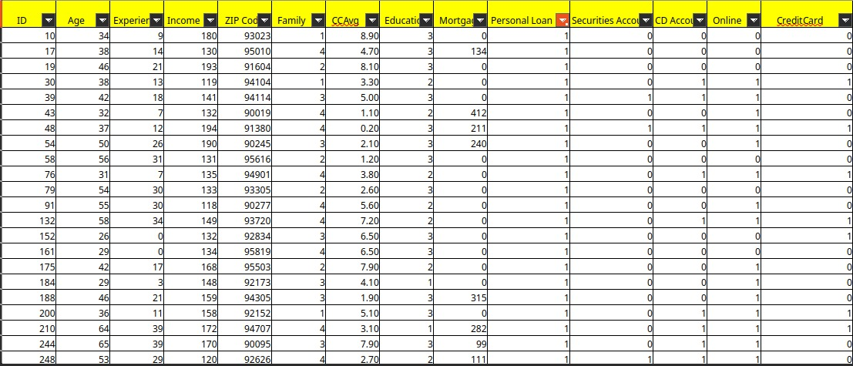
Dataset structure

Slide 4
Data description
Loan modelling is the process of building a financial model to estimate, analyse, and manage the performance of loans
It predicts if new customers will take the loans or not
It ‘s a useful idea for helping banks
it contains 13 columns and 4800 raw

Slide 5
Tools
1-preproccesing and analysis:
pandas NumPy
2-visualization:
Matplot seaborn
3-modelling :
classification models
4-Dashboard :
streamlit

